Slide 1
B.R.E.A.T.H.E
Balanced Responsive Environmental Airflow and Temperature Housing Enhancer
Senior Design: Group 40
Sponsored by: Dr. Qun Zhou Sun

Slide 2




OUR TEAM
Emily Baross
Kyle Ingleton
Marcus Loyd
Patrick Tumbos
Electrical
Engineering
Electrical
Engineering
Computer
Engineering
Computer Engineering
Notes:
Guidelines actually state professional photo of each of us so we need to change that
“In addition, you should also include
a professional photo image of you with your name and major below the image
a professional photo image of you at one of the corners in all your slides that you present”

Slide 3
01
Motivation & Background

Slide 4

Motivation and background
Issues like inconsistent airflow and poor temperature regulation.
Health implications of inadequate ventilation (e.g., carbon dioxide circulation).
Addressing discomfort in hot climates like Florida.
4500+
ppm
Very unhealthy (Exposure time limit must NOT exceed 8 hours)
2500
ppm
Negative impact on health (drowsiness and poor air quality)
1200
ppm
Upper limit for indoor concentration (stuffy/ stale air quality)
450 ppm
Acceptable conditions (outdoor air levels)
Carbon Dioxide Concentration Levels

Slide 5
02
Goals & Objectives

Slide 6
Goals
Basic Goals
The vent can be opened or closed remotely from user input.
Autonomous control of the vent will be based on user-specified temperature parameters.
The temperature of the room in which the vent is located will be regulated based on user input.
BREATHE will have a sensor that will sense the Carbon Dioxide levels in a room.
A buzzer will alert the user during necessary situations.
The power system will ensure a reliable delivery of power to each necessary component.
The device will be easy for the user to control and adjust.
Stretch Goals
The user can open the vent to a desired angle.
A mobile application will be used as a secondary way to control BREATHE.
BREATHE will incorporate a fan behind the vent to be used as a power generation feature similar to a wind turbine in order to increase battery life of the vent interaction subsystem.
BREATHE will incorporate a fan behind the vent to be used in the event that Carbon dioxide levels are high and increase airflow into the room to dissipate excess Carbon dioxide

Slide 7
Objectives
Efficient Ventilation System: Adjust airflow based on environmental conditions to maintain a comfortable living space. Such as temperature variations or CO2 levels exceeding 4500pm.
Autonomous Mode: Enable automatic adjustment of vent louvers based on user-set temperature preferences using various sensors and a servo motor.
Manual Control Capability: Allow users a manual override on the current vent position via a control unit.
Control Unit: Utilize a touchscreen LCD and sensors to accurately monitor temperature and CO2 levels and display warnings such as low battery and high CO2 levels.
Peripherals: Utilize high-precision temperature and CO2 sensors to provide real-time and reliable data.
Bluetooth Connectivity: Enable communication between MCUs for seamless operation.
Audible Alert System: Integrate a buzzer to provide clear and immediate audio alerts for critical warnings, such as low battery levels and high CO2 concentrations, ensuring user awareness and timely action.
Power System: Develop a robust power supply capable of powering all subsystems while optimizing energy usage through various low power modes.

Slide 8
03
Engineering Specifications

Slide 9
Specification | Quantitative Measure
Manual Vent Control | Vent can be in 1 of 2 positions, open or closed, from manual user input
Autonomous Vent Control | If the temperature variation is ±2°F from the desired temperature set by the user then the vent should open or close depending on whether it is above or below the desired temperature.
Sensor Accuracy | Temperature reading should be accurate to ±1°F and CO₂ reading should be accurate to ±150 ppm
Sensor Operating Range | Temperature sensor operation range should be from -40 to 176 °F, whereas the CO₂ sensor operation range should be from 0 ppm to 5000 ppm
Battery Life | Minimum duration of 6 months before needing replacement
Bluetooth Range | Bluetooth communication should work up to a 10-meter range
Dimensions | Fit inside a 14 x 6 inch air duct
Audio Alarm System | Alarm sounds when CO₂ exceeds 4500 ppm and also when the battery of the vent control unit is below 10% capacity it will sound intermittently at a lower pitch and volume. There should be only a ≤10% chance of a false alarm occurring.
Vent Actuation System | Vent will be able to fully open or close within 5 seconds

Slide 10
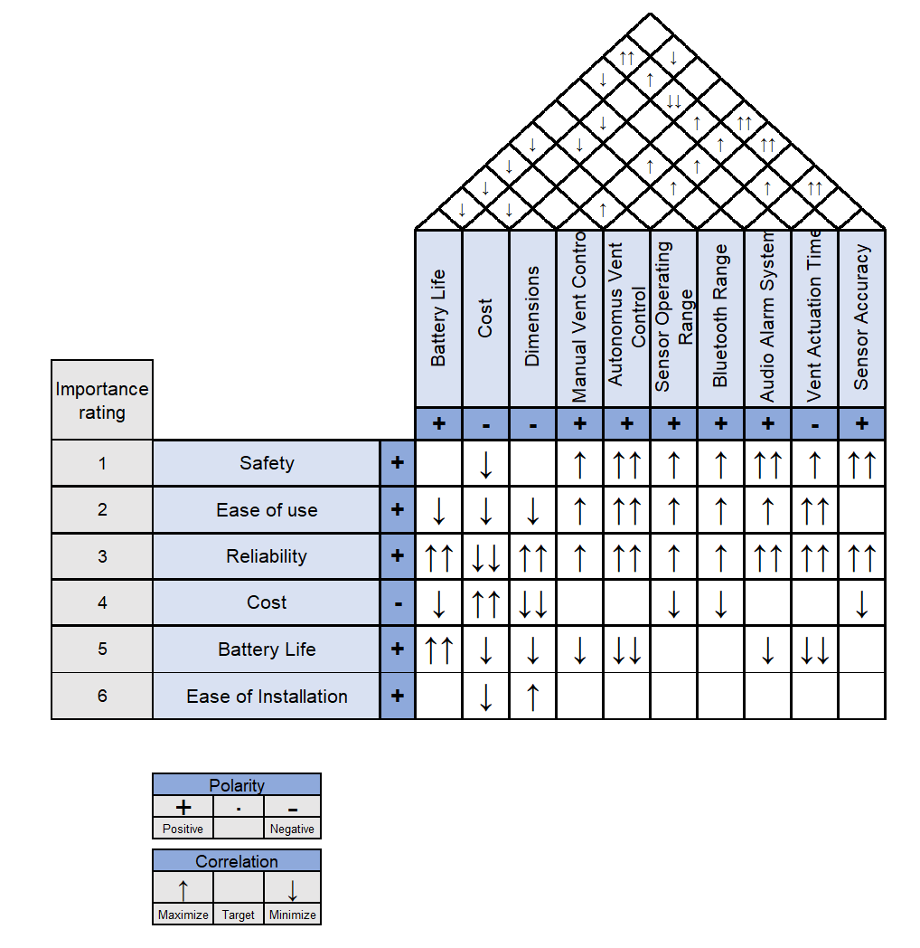
House of Quality

Slide 11
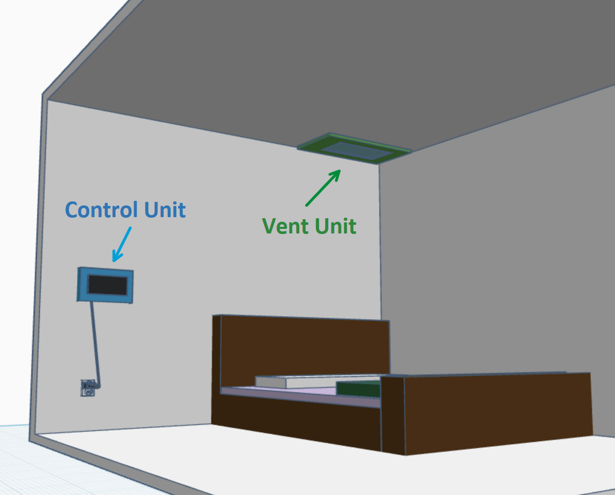
What is it?
An autonomous smart vent consisting of a Control Unit and a Vent Unit.
Control Unit:
  LCD Screen, Carbon Dioxide Sensor, Temperature Sensor, Piezo Buzzer.
Vent unit:
  Servo Motor to move the louvers.

Slide 12
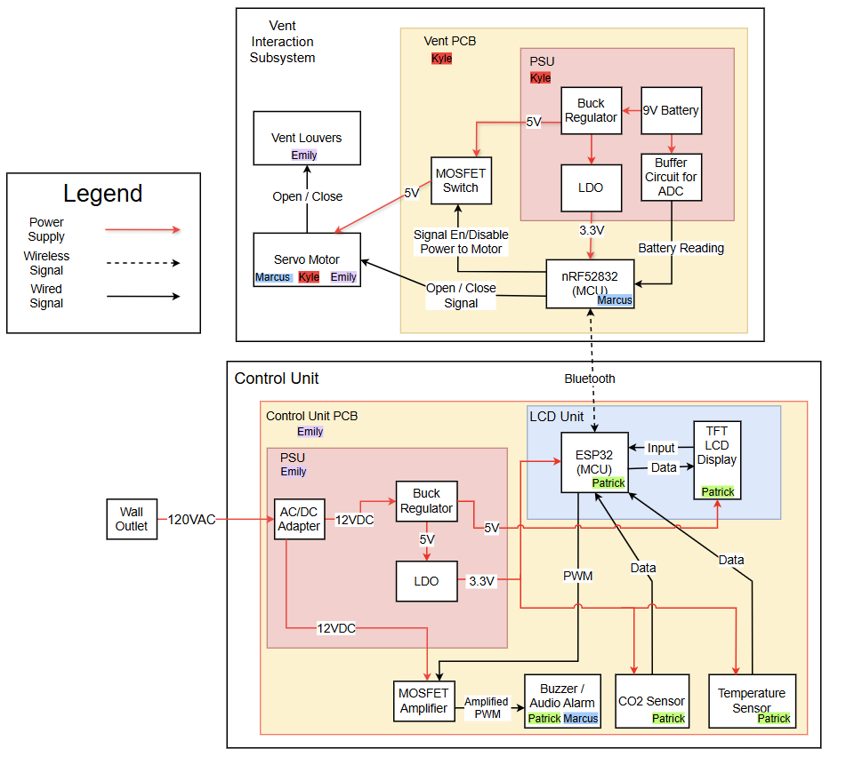
Hardware
Block Diagram
Notes:
Just needs to be moved to the right spot

Slide 13
04
Hardware Selection

Slide 14
MCU Selection
 | ESP32 |  | nRF52832 |  | STM32WB09ke | MSP430FR6989
Current Draw | 100mA |  | 100uA |  | 1.6mA | 100uA
Operating Frequency | 80 MHz to 240 MHz |  | 64 MHz |  | 64 MHz | 16 MHz
Integrated BLE | Yes |  | Yes |  | Yes | No
Ease of Integration | High |  | High / Moderate |  | Low | Low
Built-in BLE Antenna | Yes |  | Yes |  | No | No
The ESP32 was chosen for the control unit due to its high operating frequency, built-in BLE antenna, and ease of integration.
The nRF52832 was chosen for the vent unit due to its very low current draw, moderate ease of integration, and built-in BLE antenna.
Notes:
add brief text descriptions to explain your selection so that the slide is self-explainable

Slide 15
Temperature Sensor Type Selection
Sensor Type | Accuracy |  | Operating Range |  | Ease of Integration
Analog | ±0.5-1°F |  | -58°F to +302°F |  | Easy
Digital | ±0.5-1°F |  | -40°F to +257°F |  | Easy
Thermistors | ±1.8-3.6°F |  | -328°F to +2282°F |  | Difficult, requires signal conditioning, awkward form factor
Thermocouples | ±0.18-0.36°F |  | -58°F to +302°F |  | Moderate, requires calibration, awkward form factor
RTDs | ±0.18-0.9°F |  | -328°F to +1562°F |  | Moderate, may require external ICs
Although each sensor offered its own advantages, analog and digital temperature sensors were the easiest to integrate.

Slide 16
Temperature Sensor Options
Sensor | Accuracy |  | Temperature Range |  | Operating Voltage |  | Cost
LM35 | ±0.5°C |  | -55°C to 150°C/-67°F to 302°F |  | 4V to 30V |  | $1.48
TMP36 | ±1°C to ±2° |  | -40°C to 125°C/-40°F to 257°F |  | 2.7V to 5.5V |  | $1.65
DHT20 | ±0.5°C |  | -40°C to 80°C /-40°F to 176°F |  | 2.2V to 5.5V |  | $4.50
SHT30 | ±0.1°C |  | -40°C to 160°C/-40°F to 302° |  | 2.15V to 5.5V |  | $2.70
The DHT20, while most expensive offered advantages such as an internal ADC, internal temperature compensation, and comes pre-calibrated
Notes:
add brief text descriptions to explain your selection so that the slide is self-explainable

Slide 17
CO₂ Sensor Type Selection
Sensor Type | Response Time |  | Accuracy |  | Advantages | Disadvantages
Infrared (NDIR) | Moderate to Fast |  | ±50 ppm |  | High accuracy, reliable | Larger size, higher cost
Electrochemical | Slow |  | ±50 to 100 ppm |  | High sensitivity, compact, energy efficient | Slower response time due to chemical reactions
MOS | Fast |  | ±100 to 200 ppm |  | Fast response time, cost-effective, sensitive | Sensitivity to other gasses may lead to inaccuracies
Photoacoustic | Moderate |  | ±10 to 20 ppm |  | Highly accurate, stable | High cost, higher power consumption
Infrared sensors offered suitable response times and high accuracy. Moreover, other sensors listed have niche applications, and are not as easily available on the market as NDIR sensors.

Slide 18
CO₂ Sensor Options
Sensor | Accuracy |  | PPM Range |  | Operating Voltage | Cost
MH-Z19B | ± 50 ppm |  | 0 to 5000 ppm |  | 4.5V to 5.5V | $29-$38
SenseAir S8 | ±0.02% volume CO2 ±3% of reading |  | 0 to 20,000 ppm |  | 4.5V to 5.25V | $46-$59
SCD41 | ± 40 ppm |  | 0 ppm to 40,000 ppm |  | 2.4V to 5.5V | $31.02
SEN0159 | ± 50 ppm |  | 0 to 10,000 ppm |  | 3.3V to 5V | $49
The SCD41 was selected due to its accuracy and stellar operating range. Moreover,its form factor was the most compatible with our housing unit design.
Notes:
add brief text descriptions to explain your selection so that the slide is self-explainable

Slide 19
Buzzer Options
Buzzer | Dimension |  | Operating Voltage |  | Sound Pressure | Frequency | Price
PS1240 | 12.2 x 6.5mm |  | 3V |  | 70 dB | 4 kHz | $1.50
CMI 1295 | 12 x 9.5 mm |  | 4-7V |  | 85 dB | 3.6 kHz | $1.20
Jameco 5V Magnetic Buzzer | 12 x 7.5 mm |  | 5V |  | 83 dB | 3.31KHz ± 300Hz | $1.25
While several buzzers offered similar specifications, the PS1240 was the easiest to integrate while prototyping due to its compatible operating voltage with the ESP32. Moreover, it had a bonus of having the highest frequency out of the 3, allowing for more flexibility in designing alarm sounds.

Slide 20
LCD Screen Options
Screen | Touch Type |  | Resolution |  | Display Driver IC | Color Depth | Price
DFR0669 3.5” Touch Screen | Capacitive |  | 480x320 |  | ILI9488 | 262k Colors | $39.90
2.8” TFT Touch Shield | Capacitive |  | 240x320 |  | ILI9341 | 262k Colors | $24.95
WaveShare 4” LCD Screen | Resistive |  | 480x320 |  | ILI9486 | 262k Colors | $34.99
WaveShare 3.2” LCD Screen | Resistive |  | 320x240 |  | ILI9341 | 262k Colors | $28.99
The Waveshare 4” provided the most optimal resolution (480x320) for clear data visualization. Additionally, its resistive touch interface offered greater durability compared to capacitive alternatives.
Notes:
add brief text descriptions to explain your selection so that the slide is self-explainable

Slide 21
Motor Type Selection
 | AC Motors |  | Brushless DC Motor |  | Brushed DC Motor |  | Servo Motor | Stepper Motor
Torque Output | High |  | Medium |  | Low |  | High | Low
Speed Output | Very High |  | High |  | High |  | Moderate | High
Power Consumption | Very High |  | Moderate |  | Moderate |  | Moderate | Moderate
Built-in Motor Controller | No |  | No |  | No |  | Yes | No
Energy Efficiency | Good |  | Good |  | Bad |  | Good | Good
Servo motor was chosen for the motor type due to its adequate torque output and built-in motor controller.
Notes:
add brief text descriptions to explain your selection so that the slide is self-explainable

Slide 22
Servo Motor Options
 | SG92 |  | HS-5645MG |  | MG996R |  | S3004
Torque Output | 0.245 Newton-Meters |  | 1.01 Newton-Meters |  | 0.92 Newton-Meters |  | 0.314 Newton-Meters
Voltage Rating | 4.8V - 6V |  | 4.8V - 6V |  | 4.8V - 6V |  | 4.8V - 6V
Stall Current (4.8V) | 600mA |  | 2.4A |  | 1.3A |  | 400mA
Dimensions (in) | 0.9055 x 0.4803 x 1.063 |  | 1.59 x 0.77 x 1.48 |  | 1.6024 x 0.7756 x 1.689 |  | 1.6 x 0.80 x 1.4
Weight | 9 grams |  | 60 grams |  | 55 grams |  | 36.85 grams
Speed (sec/60°) | 0.1 seconds |  | 0.23 seconds |  | 0.2 seconds |  | 0.23 seconds
Price | $2-3 |  | $45.99 |  | $4.75 |  | $18
We initially chose the MG996R, but switched to the S3004 due to the lower Stall current and the adequate torque + speed.
Notes:
add brief text descriptions to explain your selection so that the slide is self-explainable

Slide 23
Power Supply Requirements
Control Unit Requirements
Vent Unit Requirements
Peripherals | Operating Voltage | Supply Current
Buzzer | 12V | 5mA
LCD Screen | 5V | 300-500mA
CO₂ | 3.3V | 15-18mA
Temperature Sensor | 3.3V | 1mA
ESP32 | 3.3V | 100-300mA
Peripherals | Operating Voltage | Supply Current
Servo Motor | 5V | 100-400mA
NRF52832 | 3.3V | 0.1-10mA
Notes:
NOTE FROM CHAN
Before presenting psu components such as energy source, converters, regulators, etc., present a power distribution table (component, supply voltage, current, etc.) so that your reader will understand the overall power requirement of the entire system.

Slide 24
Battery Considerations
 | Alkaline |  | Lithium-metal
Cost | Cheapest battery type |  | Most Expensive Primary Battery
Size | Relatively small size depending on model, comparable overall to most lithium-metal batteries |  | Relatively small size depending on model, comparable overall to most alkaline batteries
Availability | Easily accessible in any department store |  | Easily accessible in any department store
Capacity | Smallest capacity out of all battery types, meaning relatively low battery life |  | Highest capacity out of most commercial primary battery types
Lithium-metal batteries were chosen due to their relatively high capacity

Slide 25
Battery Considerations (cont.)
 | CR123 |  | 9V Battery
Cost | $20(4-pack) |  | $33(2-pack)
Size | Bigger due to 2 batteries needed |  | Smaller due to a single battery needed
Capacity | 1500mAh |  | 1200mah
Operating Voltage | 3V |  | 9V
We chose the 9V battery since it gives us the most voltage/capacity with the smallest size

Slide 26
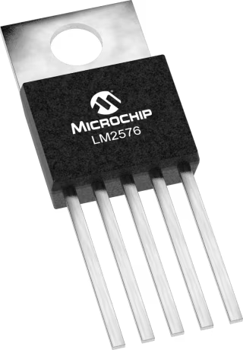
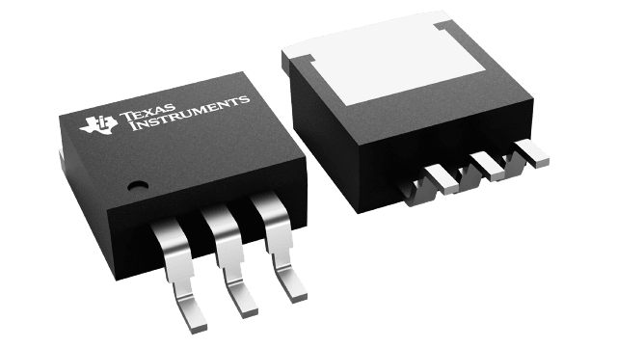
Control Unit Voltage Regulation
The control unit uses a 12V AC-DC power supply as an input
Control unit will use both regulators presented below due to their simplicity and reliability
Voltage Regulator | Output Voltage | Maximum Current Output | Quiescent Current Draw
LM2576-5 | 5V | 3A | 5-10mA
LM1117-3.3 | 3.3V | 800mA | 5-10mA

Slide 27
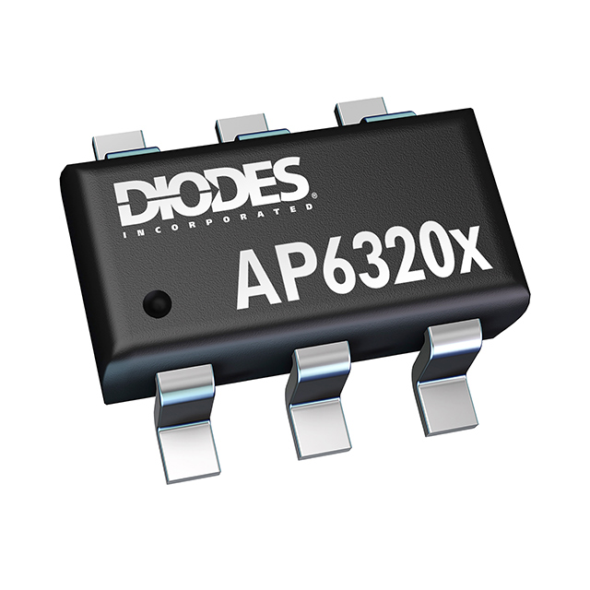
Vent Unit Power Supply Design
Since vent unit relies on battery power, efficiency and quiescent current are more important to maximize battery life
 | MAX77505 | LM2576-5 | AP63205WU
Efficiency(800mA Output) | 94% | 78% | 92%
Maximum Output Current | 3A | 3A | 2A
Quiescent Current Draw | 0.0008mA | 5-10mA | 0.022mA
Footprint(mm) | 2.0 x 2.0 QFN (0.5mm pitch) | 10.16 × 8.51 TFT (2.54mm pitch) | 2.9 × 2.8 TSOT (1mm pitch)
We chose the AP63205WU due to its low quiescent current and its footprint/design requirements which would be easy to implement.
Notes:
add brief text descriptions to explain your selection so that the slide is self-explainable

Slide 28
Vent Power Supply Considerations
For the vent unit, since efficiency is directly tied to battery life, deeper analysis must be done to consider what design would best balance complexity and battery life.
 | AP63205WU Buck Regulator(5V) + XC6206 LDO(3.3V) |  | Two AP63205WUBuck Regulators in Parallel (3.3V and 5V)
Efficiency (5V 800mA output) | 92% |  | 92%
Efficiency (3.3V 20mA output) | 66% |  | 90%
Source Current Draw ( at 3.3V with 20mA output) | 20mA |  | 12.2mA
Source Current Draw (@5V 800mA output) | 472.7mA |  | 472.7mA
Total Source Current Draw | 492.7mA |  | 484.9mA
IC Cost | $2.42 |  | $2.76
Notes:
add brief text descriptions to explain your selection so that the slide is self-explainable

Slide 29
05
Schematics

Slide 30
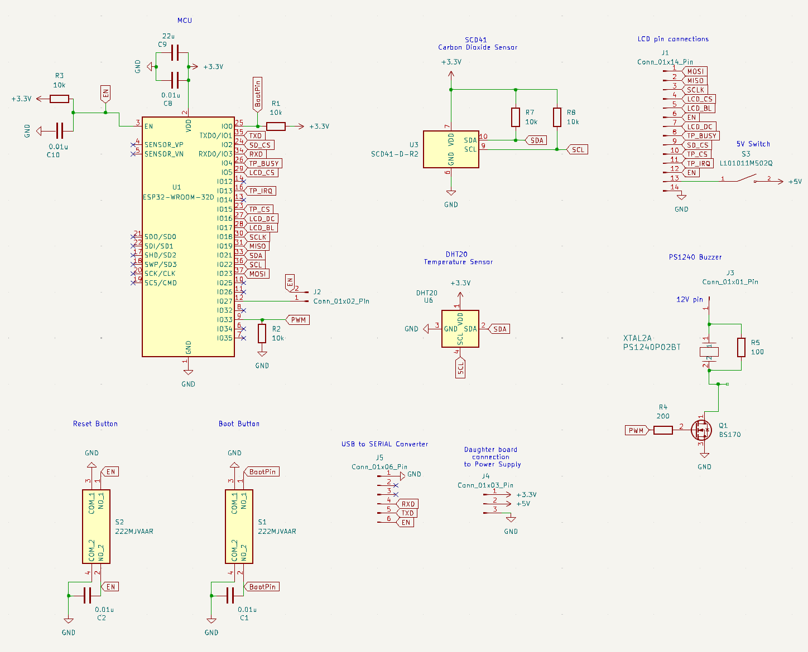
Overall Control Unit Schematic

Slide 31
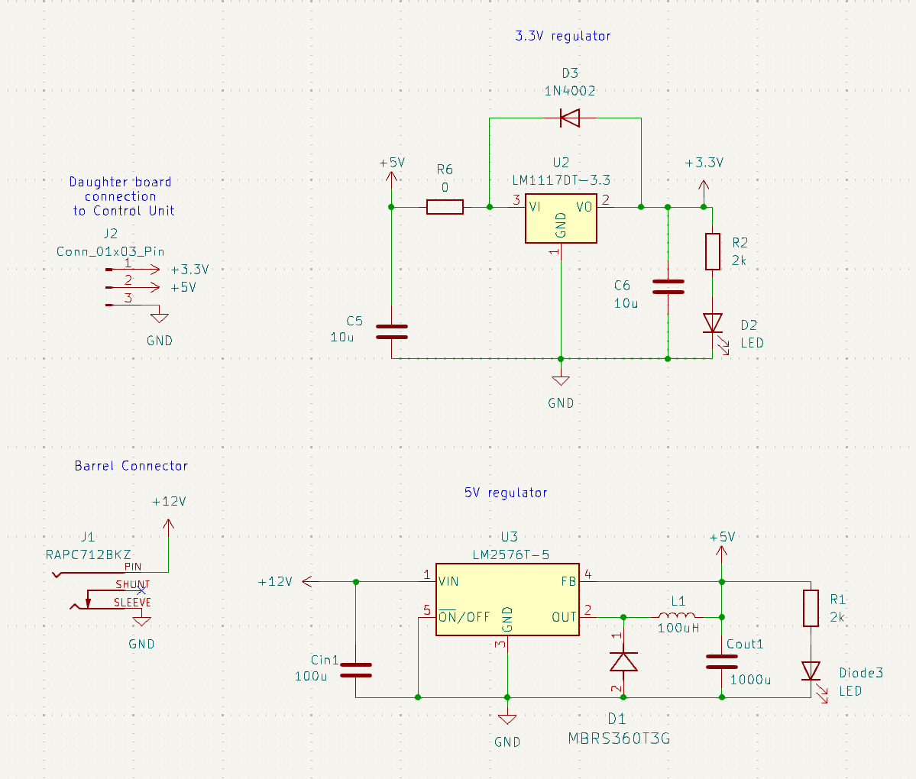
Control Unit Power Supply Schematic

Slide 32
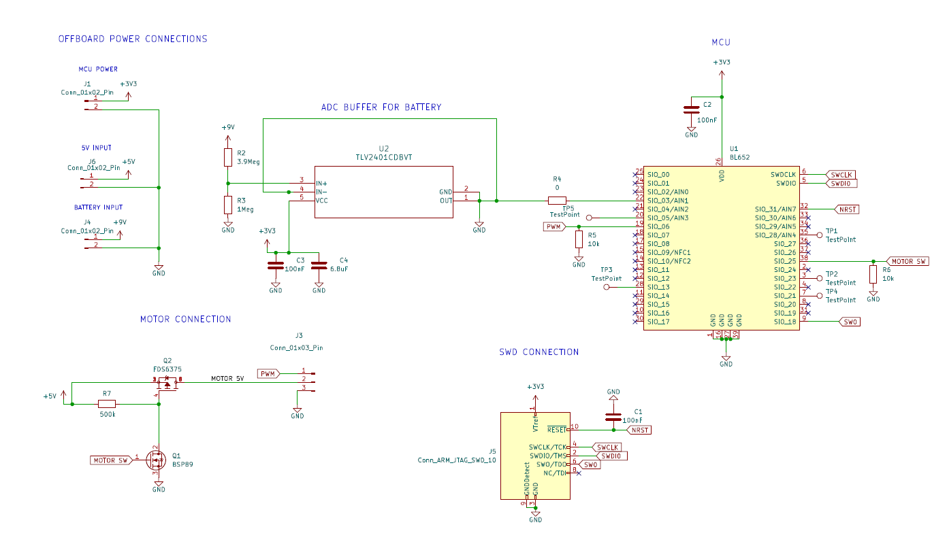
Overall Vent Unit Schematic

Slide 33
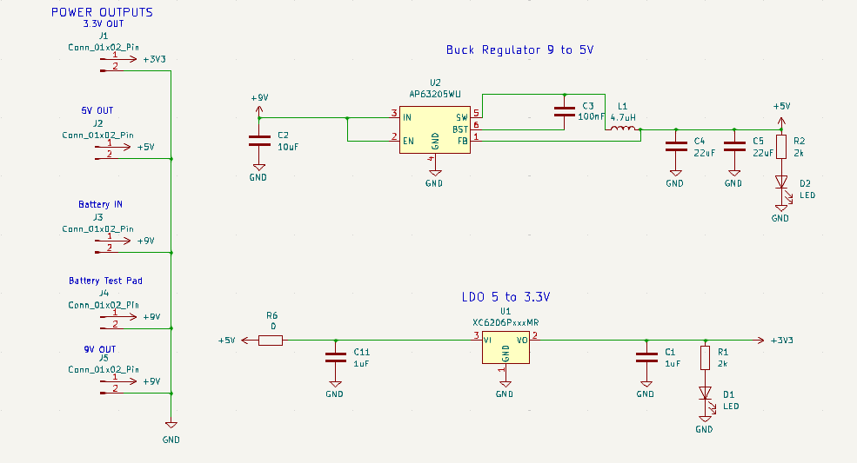
Vent Unit Power Supply Schematic
Notes:
able

Slide 34
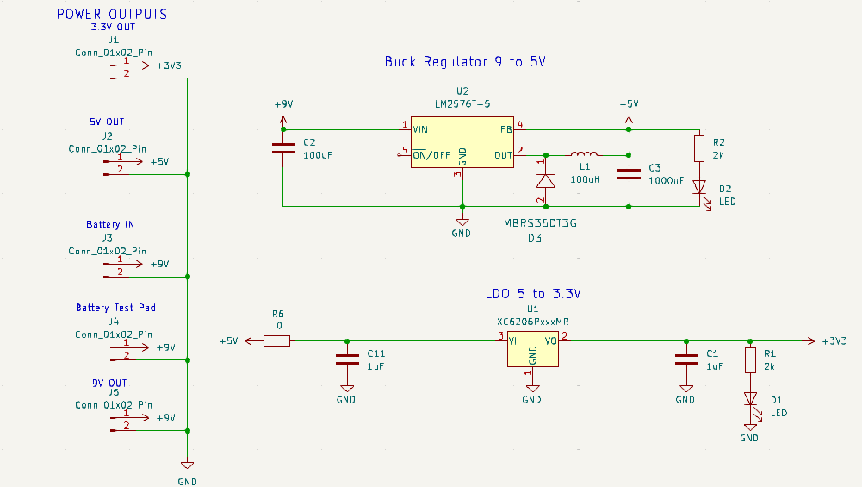
Vent Unit Backup Power Supply Schematic

Slide 35

06
PCB Design

Slide 36
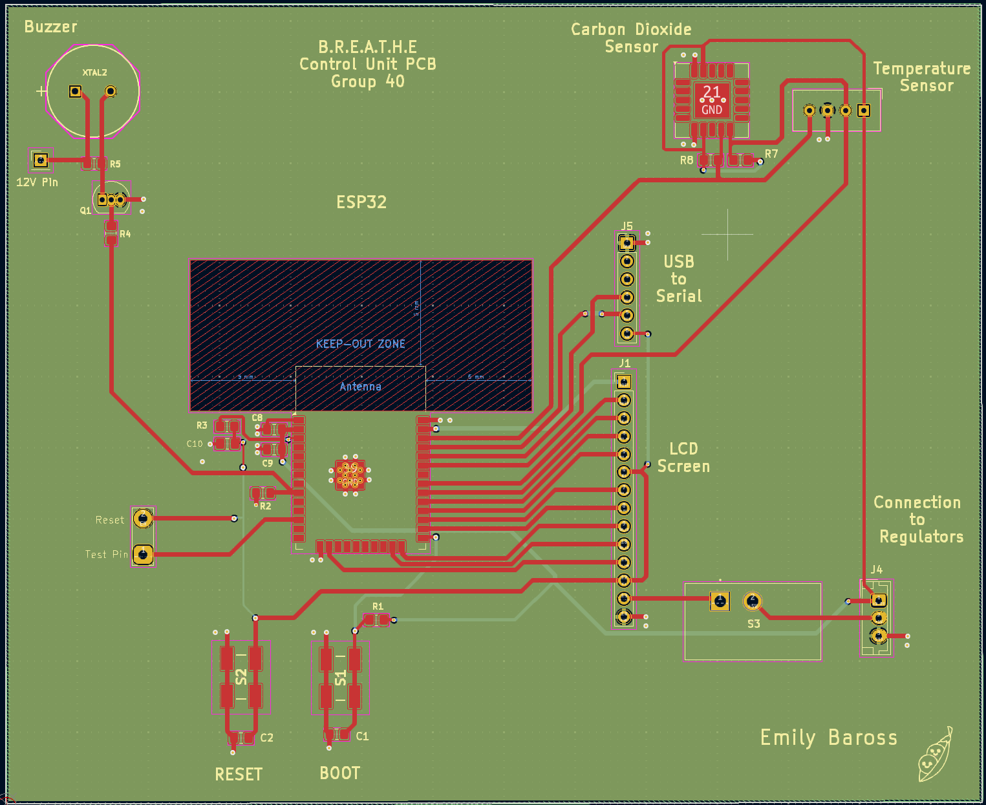
Control Unit PCB
Notes:
Utilizes a 4-layer board with 2 inner ground layers

Slide 37
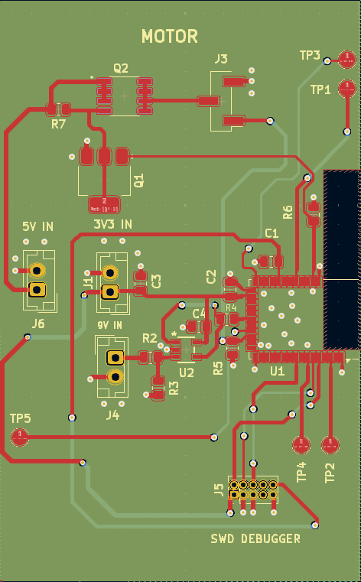
Vent Unit PCB
Utilizes a 4-layer board with 2 inner ground layers
NRF52832 antenna side is place close to the edge to maximize BLE range and efficiency

Slide 38
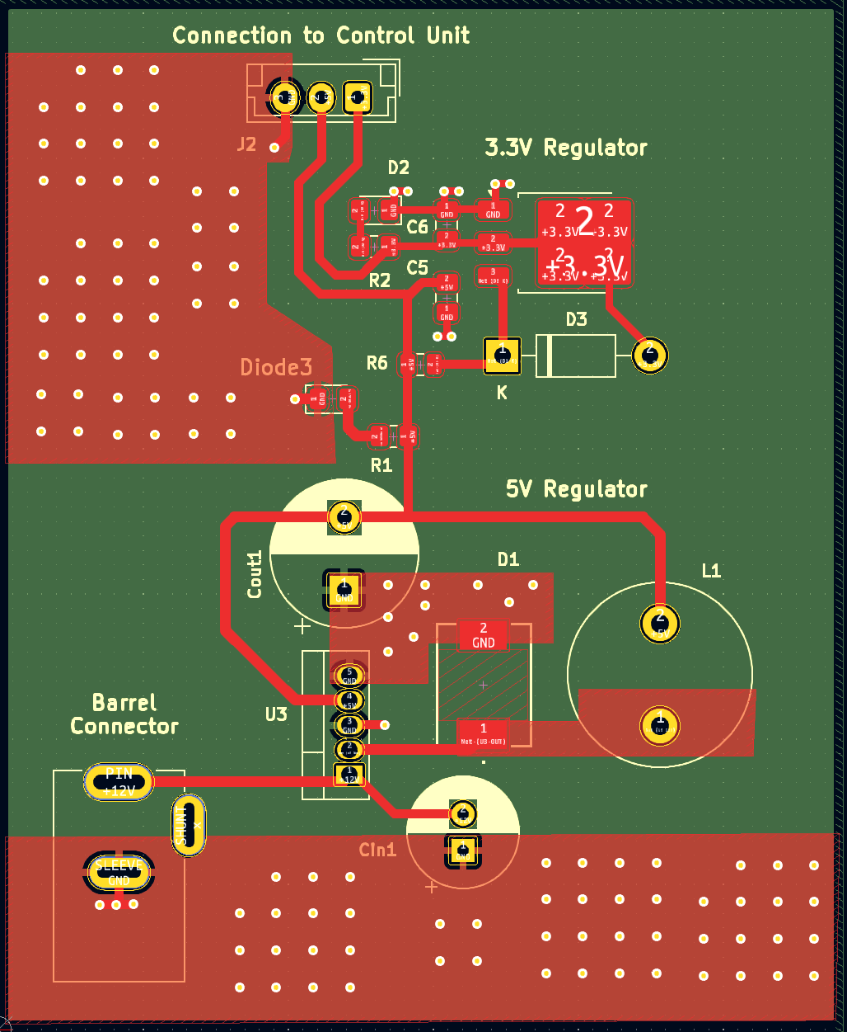
Control Unit Power Supply PCB
Notes:
label the major parts, like the previous slide

Slide 39
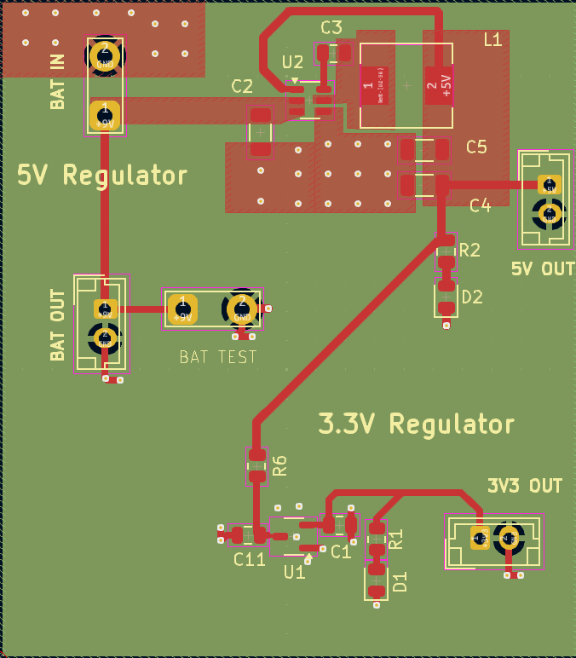
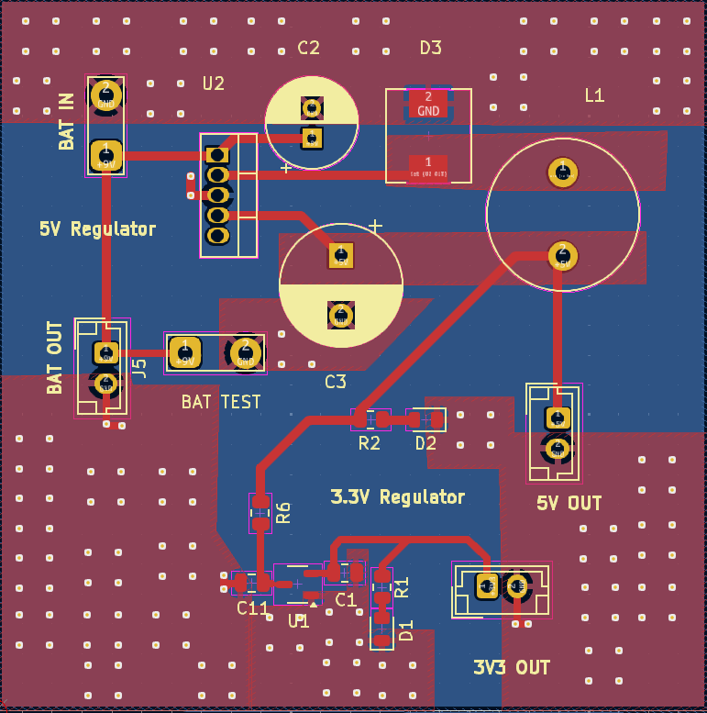
Vent unit Power Supply PCB

Slide 40
07
Communication Protocol

Slide 41
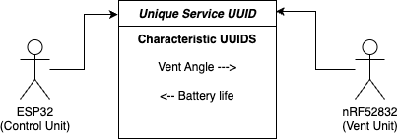
BLE Communication
Devices are able to subscribe to a service UUID to establish a connection
Each MCU can subscribe to a characteristic and publish information to it, which will automatically send a signal to the other MCU
Vent Unit will stay in low power mode until a signal is received, then adjust the vent
Control Unit will receive battery life signal and update the LCD screen

Slide 42
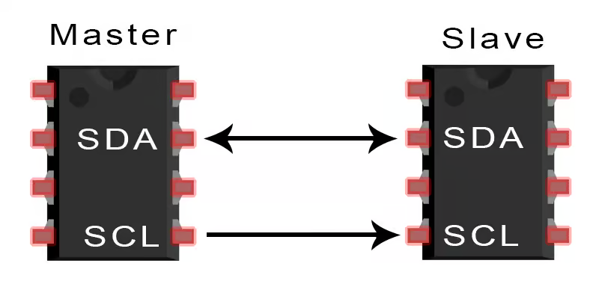
I2C Communication
Uses two main lines: serial data (SDA) and serial clock (SCL)
Master / slave relationship, master requests data and slave responds via the SDA line
Messages have unique addresses, allowing for multiple I2C devices to communicate on the same line
Used for our CO2 sensor and Temperature sensor on the Control Unit
Also used for touch screen capabilities.
Notes:
trash?

Slide 43
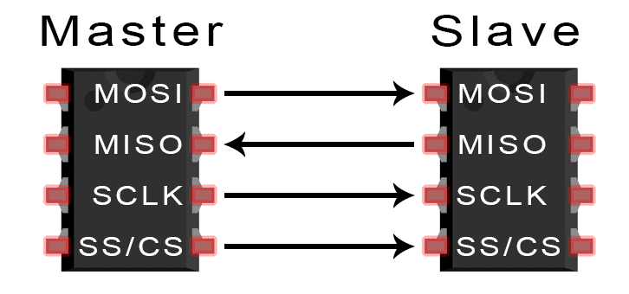
SPI Communication
Uses a master-slave architecture with four lines: Master In Slave Out (MISO), Master Out Slave In (MOSI), Serial Clock (SCLK), and Slave Select (SS).
Used for the LCD Screen’s visualization and can support higher frequencies than I2C, allowing for a faster data transfer rate
SPI frequency was also manually configurable during LCD screen development

Slide 44
07
Software Selection

Slide 45
nRF52832 Firmware
 | Adafruit (Arduino IDE) |  | Bare Metal (Nordic SDK)
Development Time | Faster |  | Slower
Current Draw LPM (@5V on development board) | 1.2mA |  | <100uA
The Adafruit firmware was used for prototyping the design due to the quick development time, and the Nordic SDK was used for the final product due to the significantly lower current draw

Slide 46
nRF52832
IDE / Dev Environments
 | Arduino IDE |  | SEGGER Embedded Studio |  | Visual Studio Code
Libraries / API / Extensions | A lot of native support (GPIO, BLE, etc), abstraction |  | Utilizes Nordic SDK, lower level |  | Lots of extensions for organization (clean code format, file exploration)
Community Support | Very High |  | High |  | High
Supported Languages | C, C++ |  | C, C++ |  | Any
Ability to upload code to Flash | Yes |  | Yes |  | No
We chose to use the Arduino IDE for initial prototype testing, and both Visual Studio Code and Segger Embedded Studio for developing the final firmware
Notes:
Same as before, all of the ides above will be used

Slide 47
ESP32 IDE Dev Environments
 | Arduino IDE |  | PlatformIO |  | Visual Studio Code
Libraries / API / Extensions | A lot of native support (GPIO, BLE, etc), abstraction |  | Provides support such as extensive library management and debugging capabilities |  | Lots of extensions for organization (neatness, file exploration)
Community Support | Very High |  | High |  | High
Supported Languages | C, C++ |  | C, C++ |  | Any
Ability to upload code to Flash | Yes |  | Yes |  | No
The Arduino IDE was selected due to substantial community support, easy prototyping and library management, and less dependency on external tools

Slide 48
08
Software Design

Slide 49
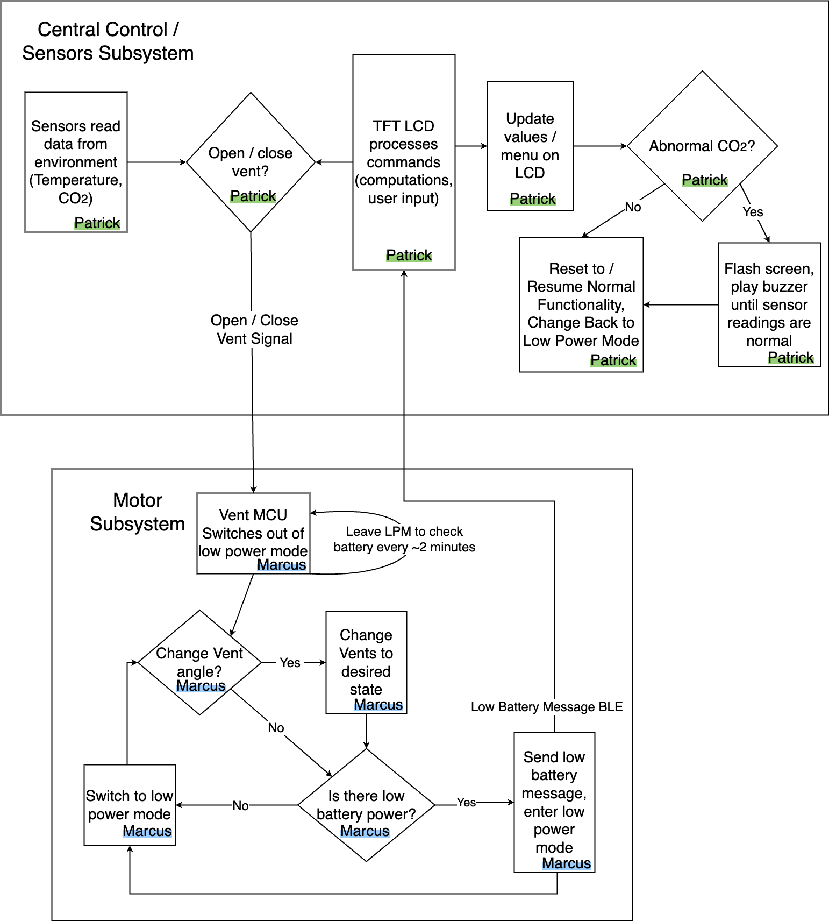
Software Block Diagram
Patrick

Slide 50
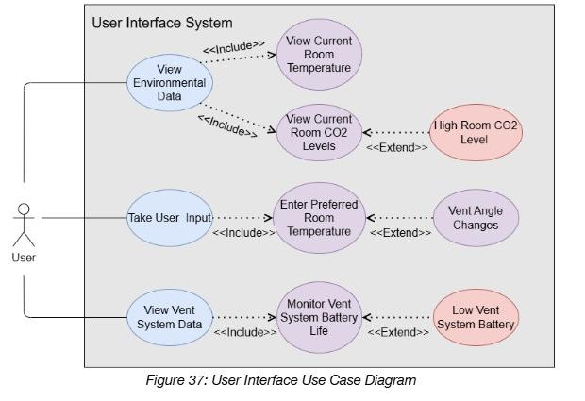
LCD Screen Use Case Diagram

Slide 51
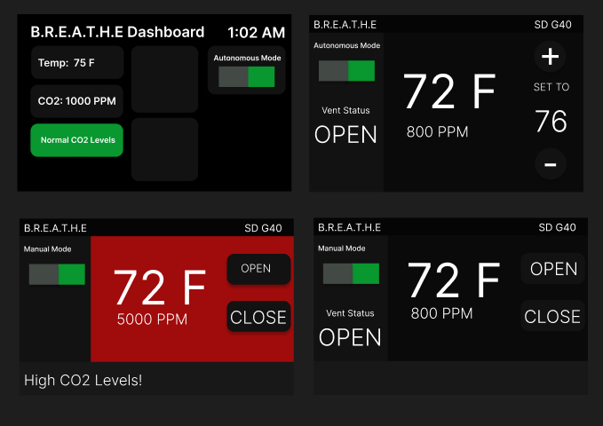
Prototype UI Designs

Slide 52
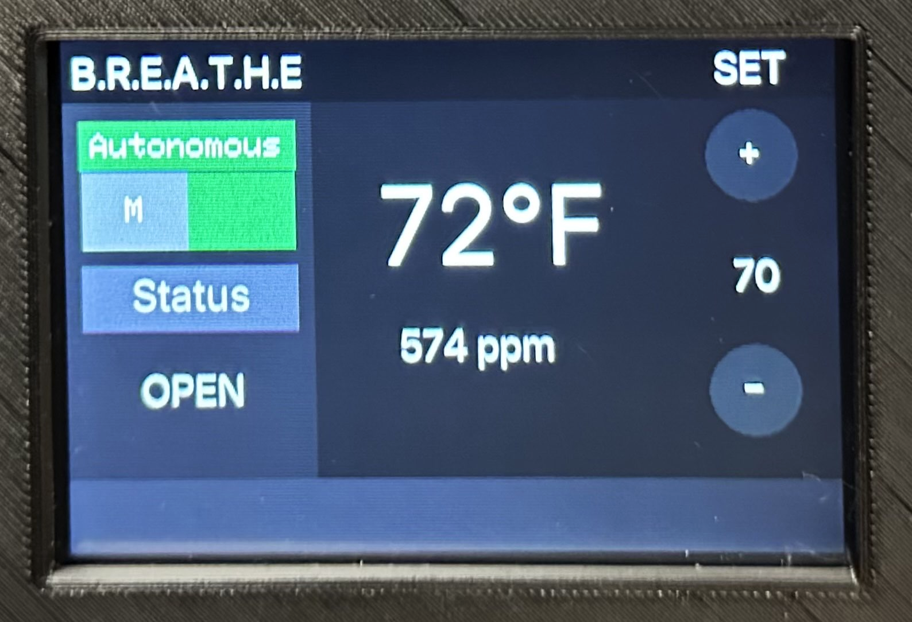
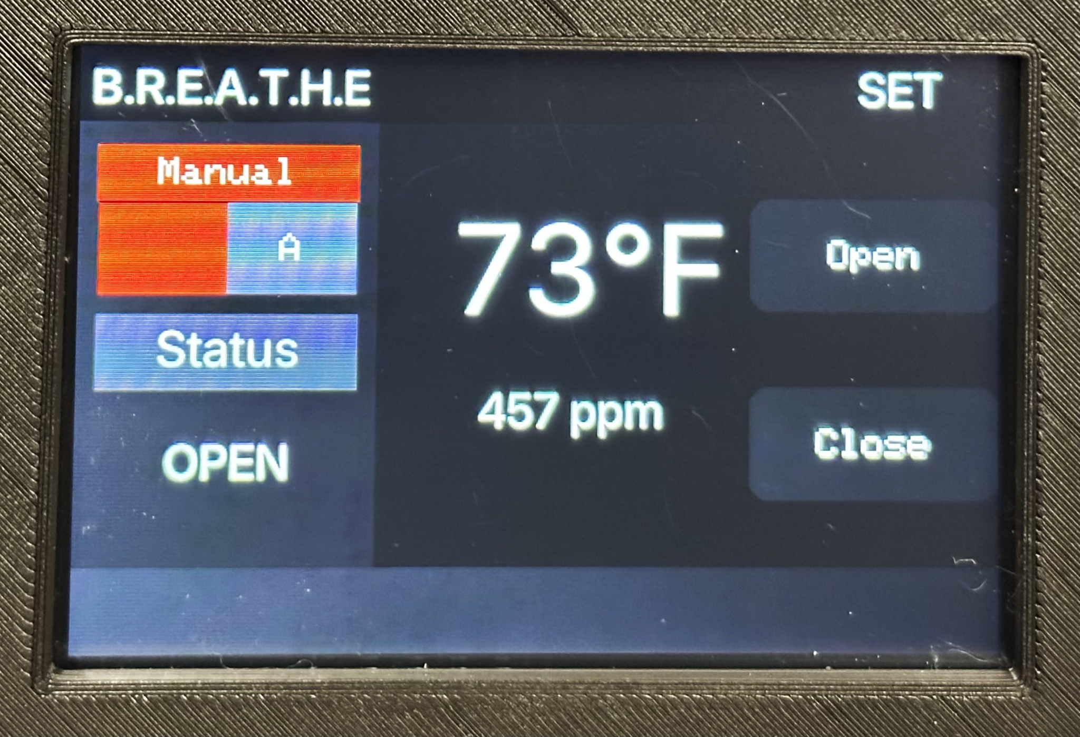
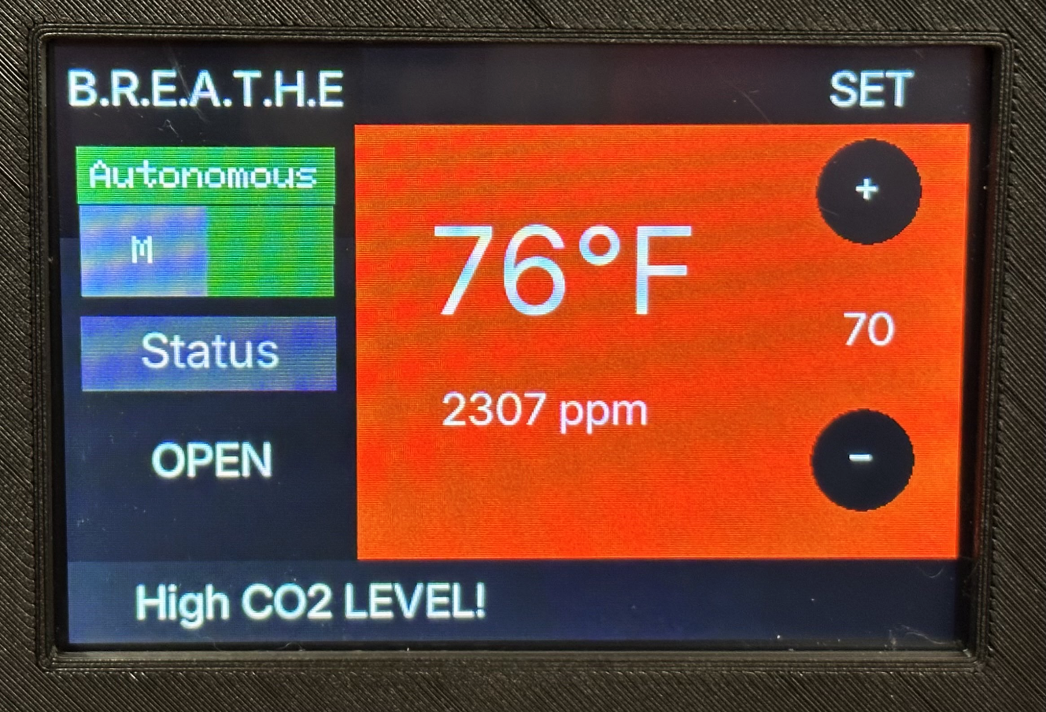
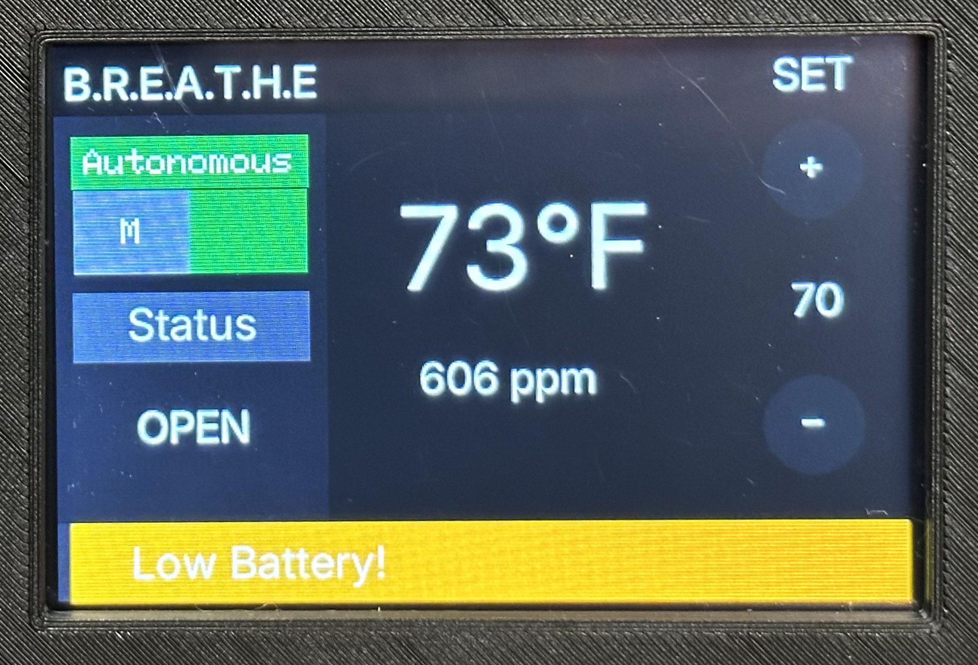
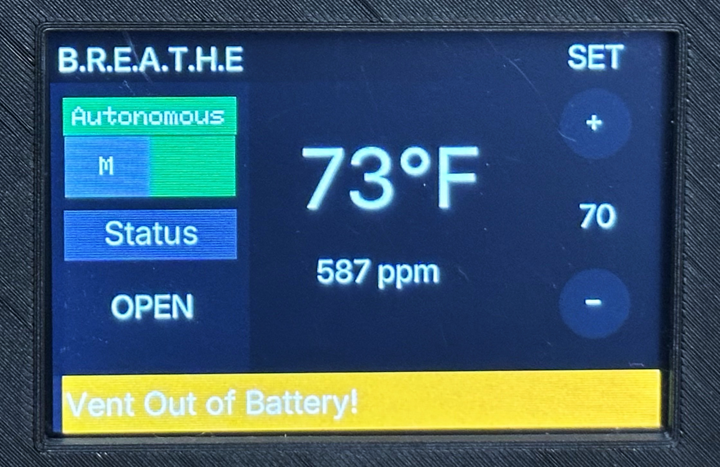
Final UI Designs
Notes:
trash?

Slide 53
09
Prototyping and Testing
Notes:
rototyping and testing
hardware and software testing
performance evaluation
success
difficulty, problem and proposed solution

Slide 54
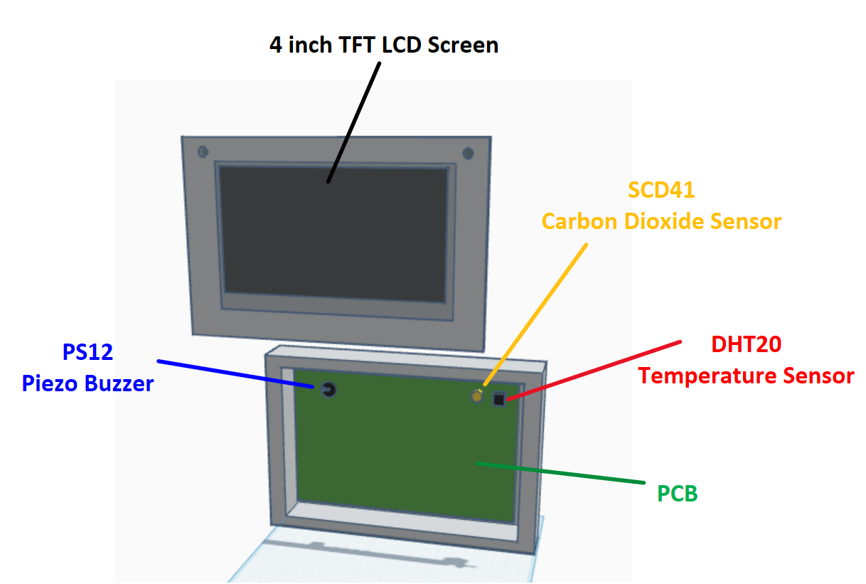
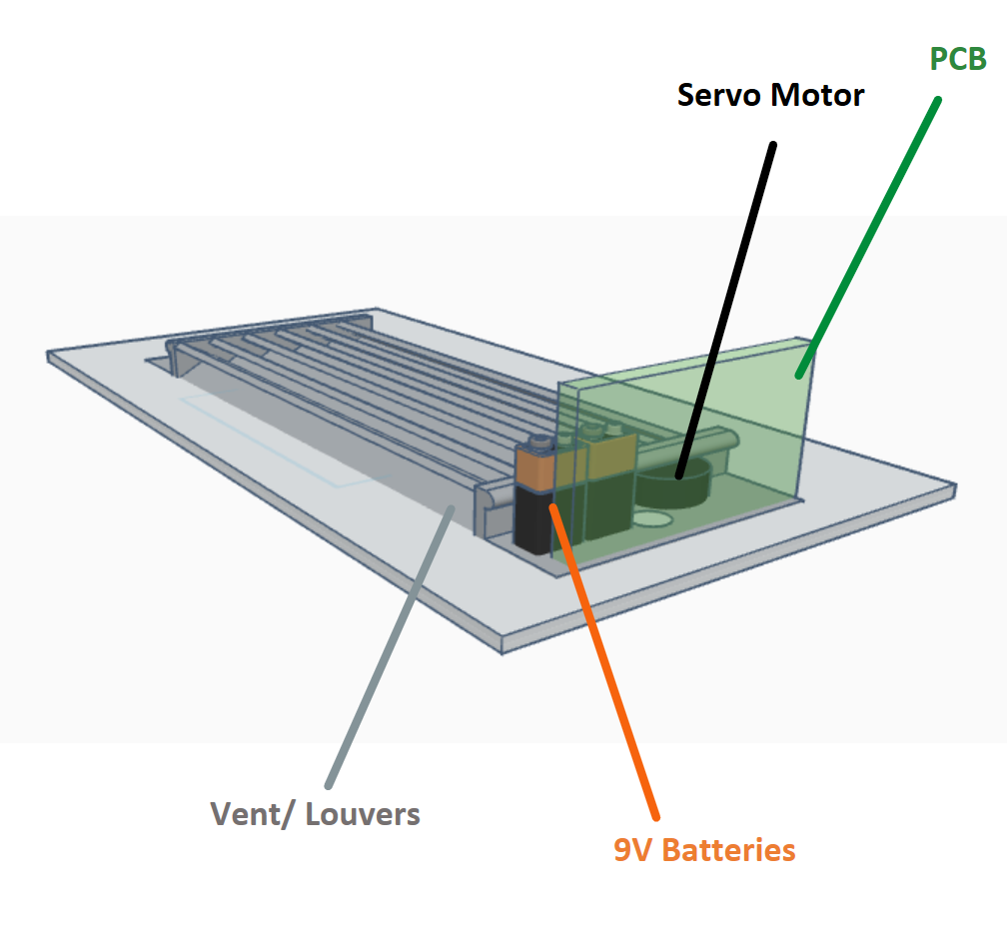
Construction Initial Design Prototype

Slide 55

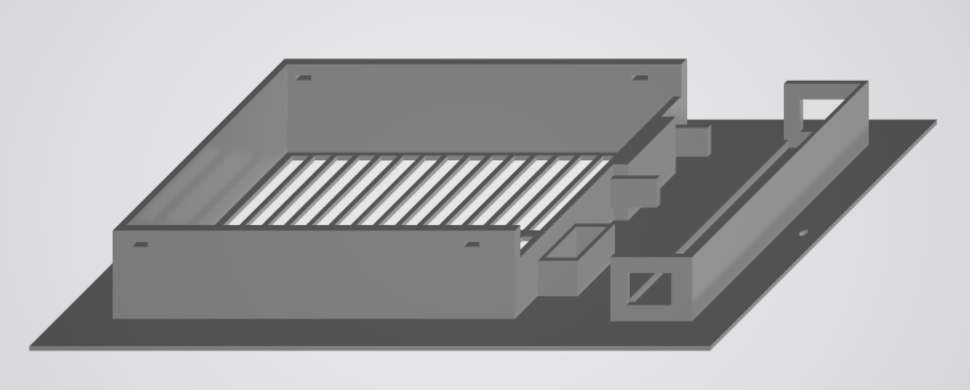

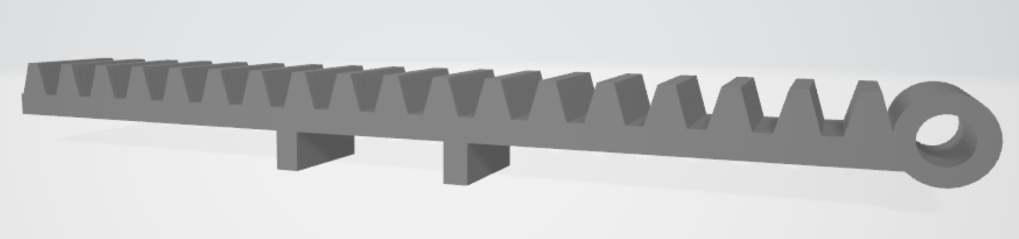
Construction Final Prototype
Control Unit Cover
Vent Cover and Housing
Rack and Pinion Gears

Slide 56
Software Testing
Software Successes:
Sensor and buzzer implementation
Autonomous/Manual mode implementation
BLE Communication
Nordic SDK implementation (ADC for battery life, BLE connectivity)
Major Challenges:
LCD screen issues affecting brightness, flashing code, and implementing UI
Conflicts in combining subsystem codes for nRF52832
Setting up UUIDs w/ the Nordic SDK
Solutions:
Configuring the backlight pin, separating PWM channels, ensuring the pins on the PCB matched the configured pins on the user setup file.
Initially wanted to use LVGL, a robust embedded graphics library, found more success using TFT_eSPI
Adjusting the configuration file, reconfiguring pins and timers, and modifying include directories
Changing the UUIDs to fit the format that the Nordic SDK can interpret
Notes:
Notes from Chan
Show the test results. For your final presentation, you need to present a lot more test results explicitly, including measurements, outcomes from multiple runs, etc.

Slide 57
Hardware Testing
Hardware Success:
Buzzer, Carbon Dioxide, and Temperature sensor testing.
The High-side MOSFET switch design to cut 5V when the motor is stalling/idle
Majors Challenges:
PCB Troubleshooting.
Battery Power Consumption.
Code flashing.
Motor integration
Solutions:
Multiple different Regulator
Use a LCD screen that has a graphics driver with more documentation such as the ILI9341.
The first proposed solution was to implement an automatic reset circuit with BJT transistors connected to the buttons, however this did not work. Our final solution was to implement a switch connected to the 5V source because we found out that 3.3v and 5V could not simultaneously be connected to the MCU while flashing
Notes:
difficulties faced, problems encountered, and proposed solution.
For your final presentation, discuss major challenges and your solutions to them including those that did not work,

Slide 58
Future
What we would have done differently and proposed improvements:
Implement our strech goals by,
  Incorporating a fan behind the vent to be used as a power generation feature similar to a wind turbine in order to increase battery life of the vent unit, and increase airflow into the room to dissipate excess Carbon dioxide.
  Having the user be able to open the vent to a desired angle.
  Incorporating a mobile application that can be used as a secondary way to control BREATHE.
Make the everything more compact.
Redesign the system around a rechargable battery feature.
Utilize different means in order to create the UI, TFT_eSPI wasn’t as robust as other embedded UI methods could have been.
Use a graphics driver with more documentation such as the ILI9341.

Slide 59
10
Administrative Content

Slide 60
Budget
Item |  | Price |  | Quantity
NRF52832 DevKits |  | $24.95 |  | 2
NRF52832 module |  | $9.29 |  | 5
ESP32 WROOM 32 |  | $5.30 |  | 3
PCBs |  | $9.74 |  | 40
PCB Additional Components |  | $390.07 |  | N/A
Amazon Carbon Dioxide Monitor |  | $39.99 |  | 1
Carbon Dioxide Sensor |  | $37.10 |  | 4
Temperature Sensor |  | $4.50 |  | 6
Item |  | Price |  | Quantity
LCD Screen |  | $41 |  | 2
Batteries |  | $18 |  | 5
Buzzer |  | $0.56 |  | 10
Sample Vent |  | $26.60 |  | 1
Servo Motor |  | $7.20 |  | 5
J-Link Debugger |  | $60 |  | 1
ESP32 Debugger |  | $6 |  | 2
Total |  | $1,448.68

Slide 61
Work Distribution
Responsibilities | Primary Member | Secondary Member
Power Supply Design | Kyle Ingleton | Emily Baross
Vent Interaction subsystem PCB Design | Kyle Ingleton | Emily Baross
Control Unit PCB Design | Emily Baross | Kyle Ingleton
Vent Interaction Subsystem Software Design | Marcus Loyd | Patrick Tumbos
Control Unit Software Design | Patrick Tumbos | Marcus Loyd
LCD and GUI Design | Patrick Tumbos | Marcus Loyd
Carbon Dioxide Sensor Testing | Patrick Tumbos | Emily Baross
Temperature Sensor Testing | Patrick Tumbos | Emily Baross
Motor Testing and Configuration | Marcus Loyd | Emily Baross
Vent Interaction Subsystem Enclosure Design/Testing | Emily Baross | Marcus Loyd
Control Unit Enclosure Design/Testing | Emily Baross | Patrick Tumbos
Buzzer configuration and Testing | Marcus Loyd | Patrick Tumbos

Slide 62
Plan for completion
PCB Testing
(2/24 - 3/10)
Vent + Control Unit Subsystem integration testing
(3/10 - 3/24)
Control Unit GUI Completion
(3/24 - 4/1)
Nordic SDK Integration
(3/24 - 4/1)
Preparation for final Demo
(4/1 - 4/7)
Notes:
trash?

Slide 63

Thanks for watching!

